Slide 1
Using the async Pipe

Slide 2
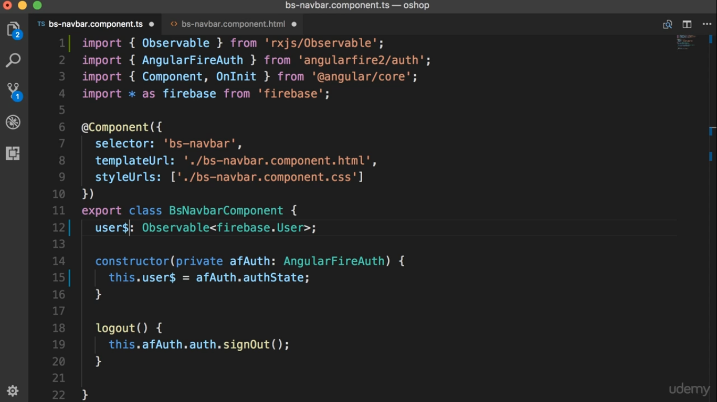

Slide 3
